Slide 1
Reporting SNA results

Slide 2
Project description
Research context
Who are the nodes?
Number of nodes
Nodal attributes
What types of ties?
Directed/Non-directed

Slide 3
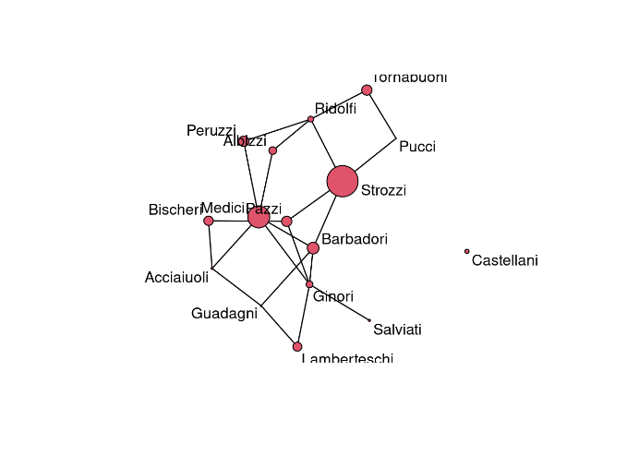
Network visualization (VPNet)

Slide 4
Descriptive Statistics
Attributes
Visualisations of binary/continuous/categorical attributes
Correlation analysis
Networks
NetworkX

Slide 5
ERGM (Table)
Effect Lable | Effect meaning | Configuration | Math Definition | para. | s.e. | t-ratio | SACF | p-value | CI | Significance | Interpretation
Density | Density |  | sum(Xij) | -2.1 | 1.1 | 0.05 | 0.3 |  | (-4.3, 2.1) |  | Lower than expected density
Two-star | Centralization |  | sum(Xij*Xik) | 1.5 | 0.2 | -0.02 | 0.2 |  | (1.1, 1.9) | * | Ties are centralized on a few nodes
Triangle | Network Closure |  | sum(Xij*Xjk*Xik) | 1 | 0.3 | -0.03 | 0.1 |  | (0.4, 1.6) | * | More closure than expected

Slide 6
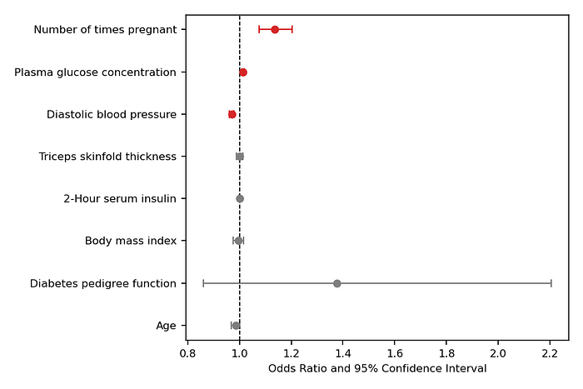
ERGM (Visualization)
Forest-plot
Visualizing conditional log-odds

Slide 7
ERGM Goodness of Fit (GOF)
Table
Table
Statistics | meaning | Configuration | Math Definition | obs. | mean | s.d. | t-ratio | Significance | Interpretaion
 |  |  |  |  |  |  |  | ! | model distribution produced more such statistics than observed (if t>1.96)
 |  |  |  |  |  |  |  |  | model distribution produced les such statistics than observed (if t<-1.96)

Slide 8
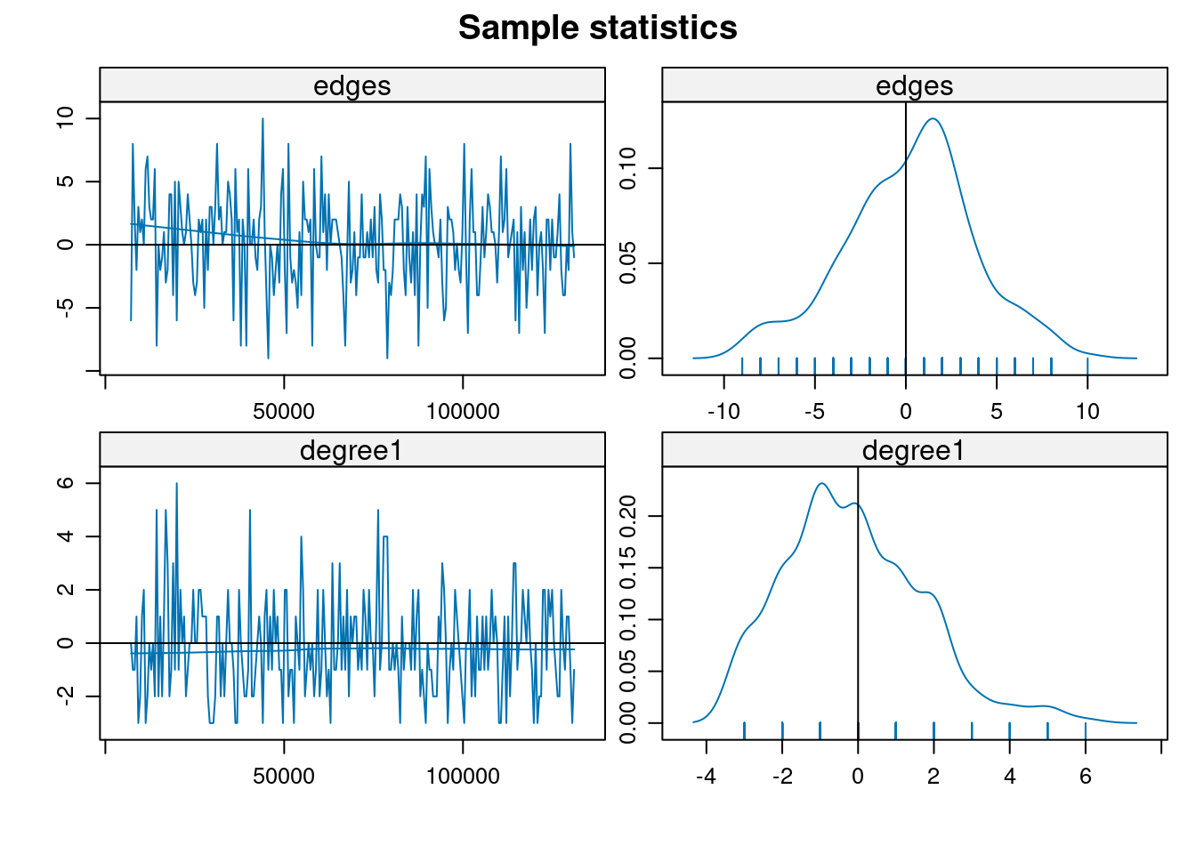
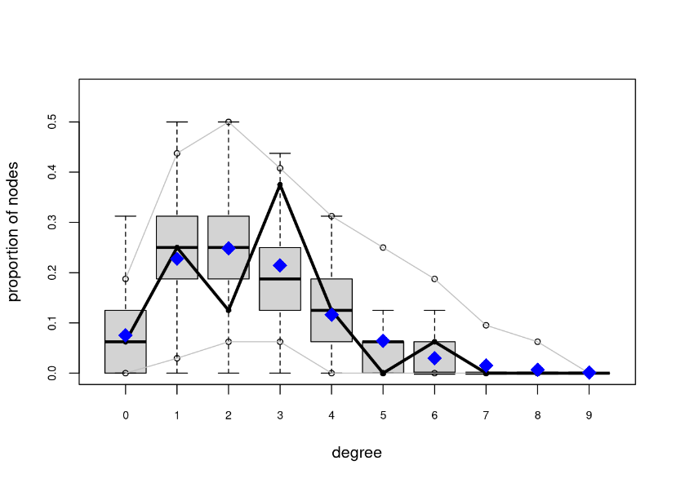
Simulation/GOF visualizations
Sample statistics
Degree distributions

